Slide 1
Value of crowdsourced data in earthquake response and analysis
Max Roland
Kristin Robinson

Slide 2
Max
Kristin
University of Colorado
Geography - GIS Major
EarthLab Research Assistant
Research into large scale natural hazard events and mitigation
University of Colorado
Computer Science Major
LEGO Head of Digital Analytics
Analysis of consumer data from digital content
@Kristin_CUBoulder
Notes:
Why listen to Max:
Why listen to Kristin:
Non-traditional student who started at Dartmouth as a history major and is completing degree in Computer Science at CU Boulder
Between Dartmouth and CU I headed up the global digital analytics at LEGO. Spent my time analyzing consumer data from LEGO digital content (ex. websites, apps)
Love data and playing with data.
Unnatural obsession segue ways into why we chose this project…

Slide 3
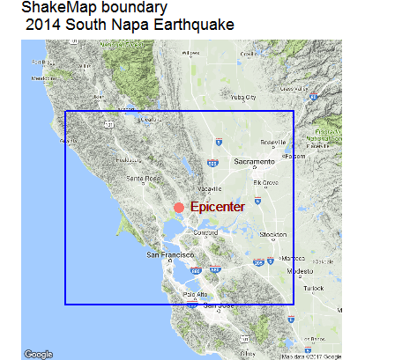
area of interest
Notes:
Shakemap
representation of actual ground shaking
focuses on the ground shaking produced by the earthquake, vs. descriptive parameters – epicenter, magnitude
based on point location measurements of the ground motion as recorded by seismometers,
and shaking intensity is estimated from these recordings by relating these recorded or interpolated ground motions to seismic intensity (for technical details, see Worden et al., 2010). (2)
range of ground shaking levels at sites throughout the region, depending on
distance from the earthquake fault that rupture
the rock and soil conditions at sites,
and variations in the propagation of seismic waves due to structure of the Earth’s crust.(1)
Contours indicate intensities
Triangles – shakemap stations
Colors – intensity value
peak ground-acceleration, velocity, and spectral acceleration as well as MMI. (1)
1 http://usgs.github.io/shakemap/introduction.html
2 https://earthquake.usgs.gov/data/dyfi/background.php

Slide 4


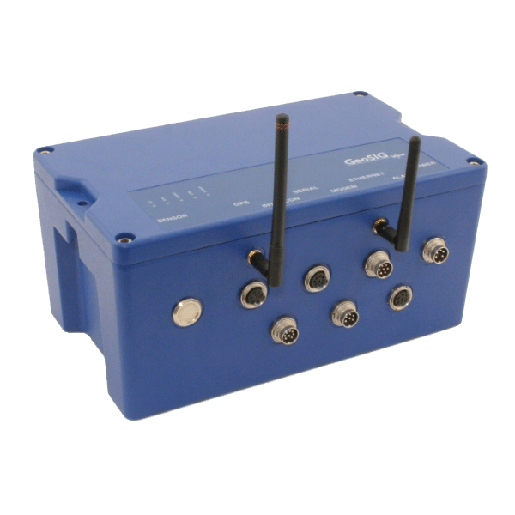
why?

Slide 5
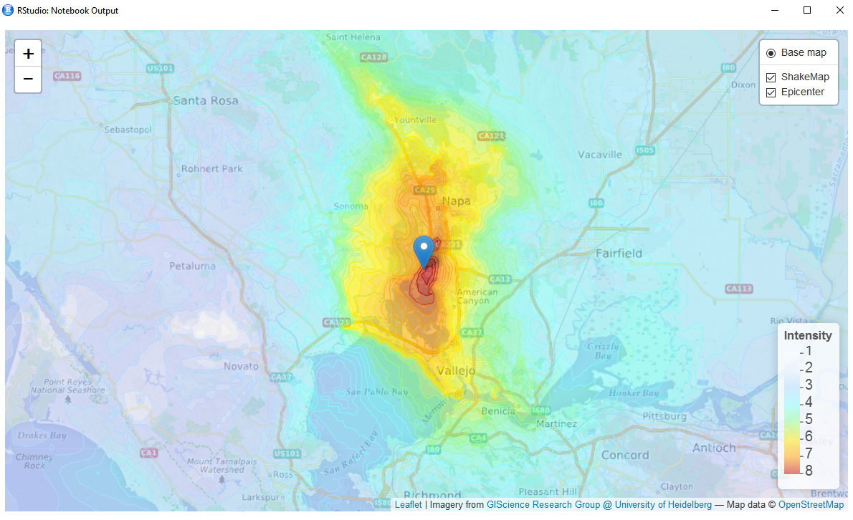

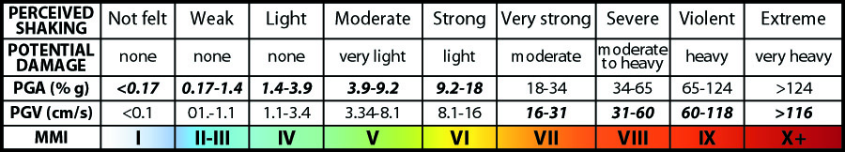
ShakeMap data
Notes:
Shakemap
representation of actual ground shaking
focuses on the ground shaking produced by the earthquake, vs. descriptive parameters – epicenter, magnitude
based on point location measurements of the ground motion as recorded by seismometers,
and shaking intensity is estimated from these recordings by relating these recorded or interpolated ground motions to seismic intensity (for technical details, see Worden et al., 2010). (2)
The effect of an earthquake on the Earth's surface is called the intensity. The intensity scale consists of a series of certain key responses such as people awakening, movement of furniture, damage to chimneys, and finally - total destruction. Although numerous intensity scales have been developed over the last several hundred years to evaluate the effects of earthquakes, the one currently used in the United States is the Modified Mercalli (MM) Intensity Scale. It was developed in 1931 by the American seismologists Harry Wood and Frank Neumann. This scale, composed of increasing levels of intensity that range from imperceptible shaking to catastrophic destruction, is designated by Roman numerals. It does not have a mathematical basis; instead it is an arbitrary ranking based on observed effects
range of ground shaking levels at sites throughout the region, depending on
distance from the earthquake fault that rupture
the rock and soil conditions at sites,
and variations in the propagation of seismic waves due to structure of the Earth’s crust.(1)
Contours indicate intensities
Colors – intensity value
https://earthquake.usgs.gov/learn/topics/mercalli.php
1 http://usgs.github.io/shakemap/introduction.html
2 https://earthquake.usgs.gov/data/dyfi/background.php

Slide 6
twitter data

Slide 7
twitter data processing

Slide 8
results

Slide 9
challenges

Slide 10
conclusion

Slide 11
thank you

